Slide 1
Flood area segmentation using neural networks
Haider Ali

Slide 2
Problem overview
There are lot of Flood events happening and it becomes very critical to identify amount of area affected my it.
By identification the rescue team can make informed decisions for ex. Number of rescue members needed for a particular area.
It can be used for urban planners and policymakers to make informed decisions regarding land use, infrastructure development, and flood mitigation measures
Climate change: Identifying climate change by measuring the flood impact according to time constraint to measure climate change.
Humanitarian Aid: It can help government and NGO’s to prioritize resources based on severity of flood.
Urban planning: It assists in prioritizing repair and maintenance work, ensuring timely interventions and reducing infrastructure downtime

Slide 3
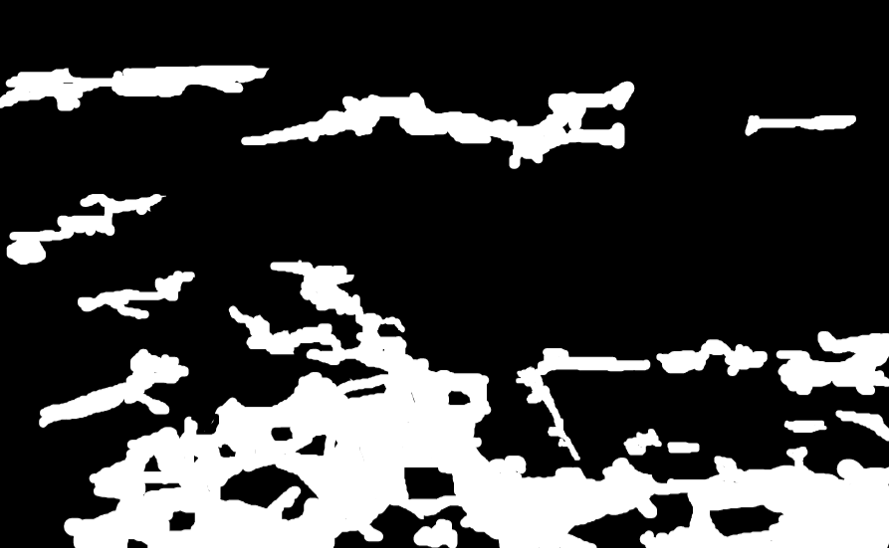
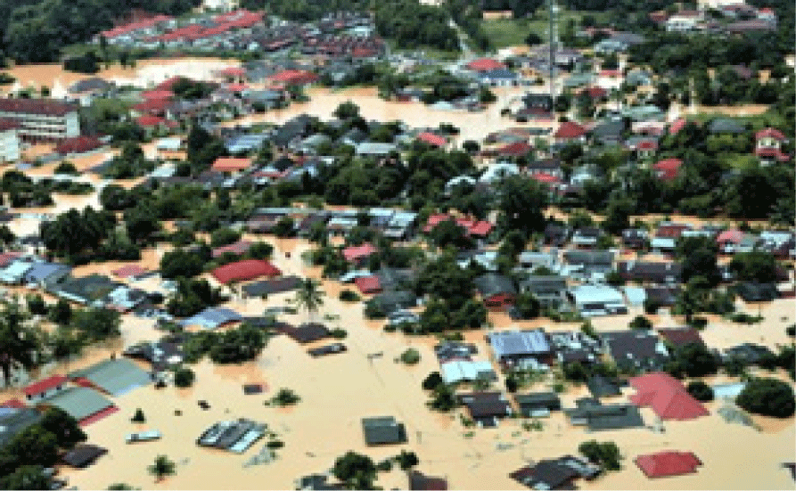
Dataset
This dataset taken from Kaggle uploaded by Faizal Karim and 2 more collaborators.
The dataset contains images of flood hit areas and corresponding mask images showing the water region.
The dataset contains 290 images with their masks which are further split into test size 58 and train size 231 images

Slide 4
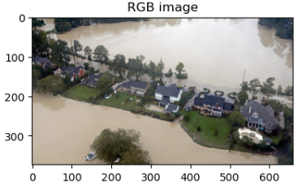
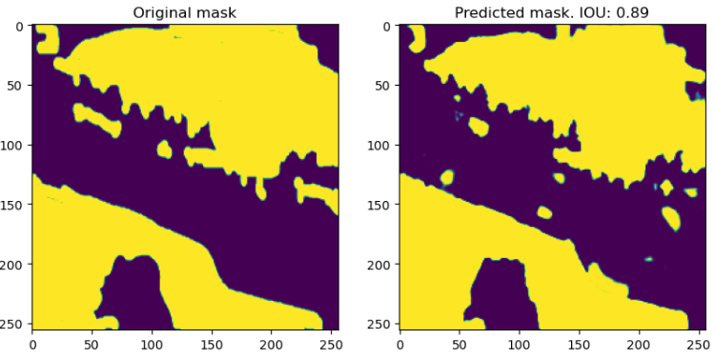
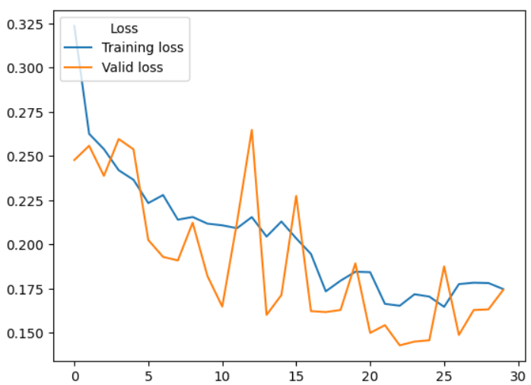
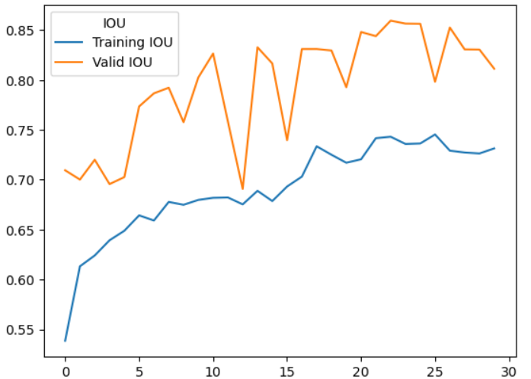
UNet

Slide 5
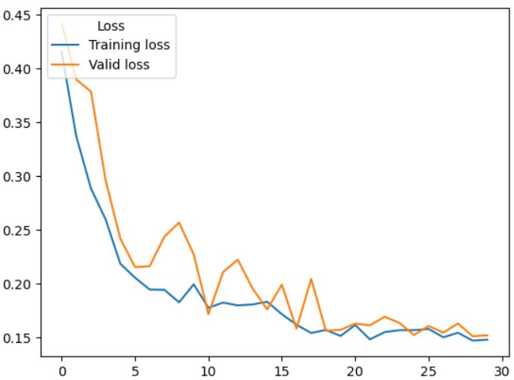
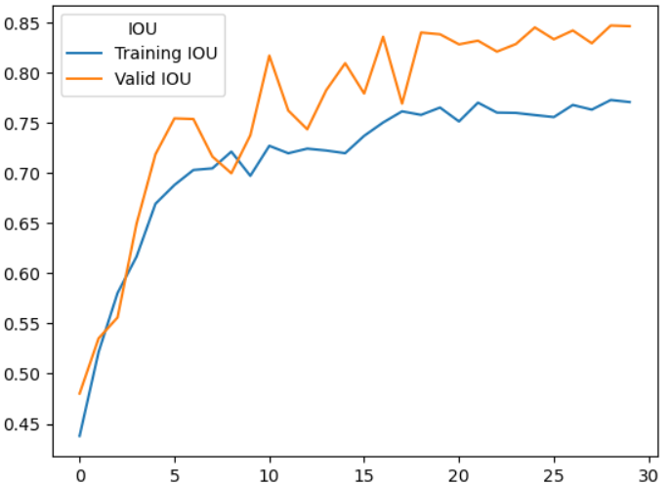
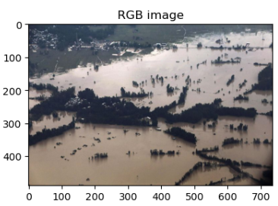
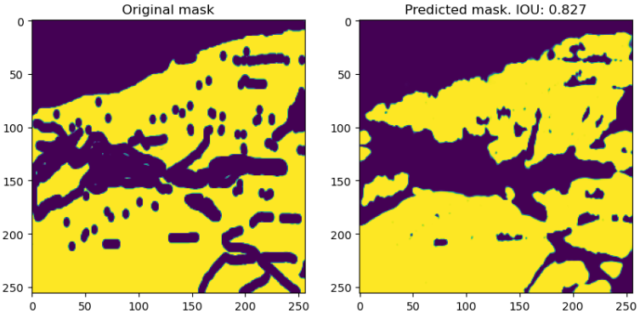
U2Net

Slide 6
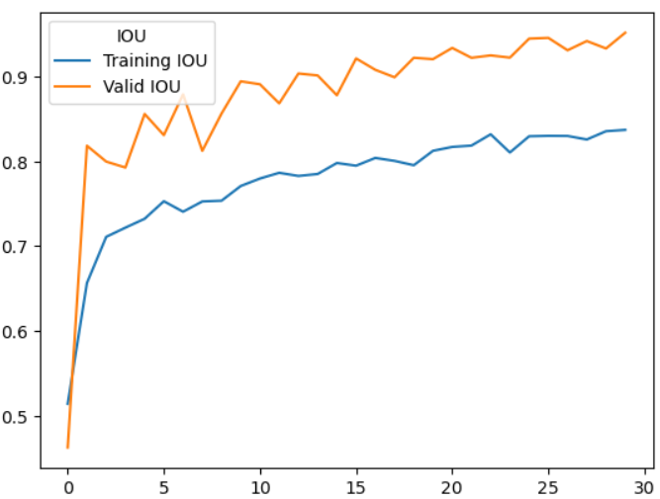
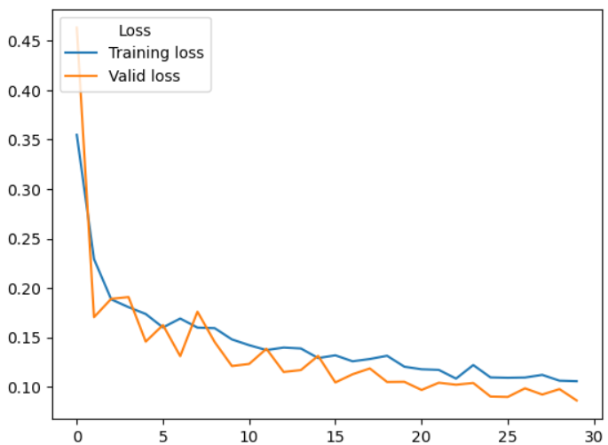
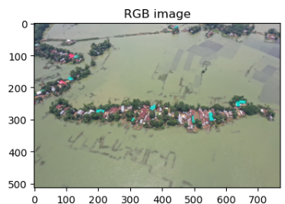
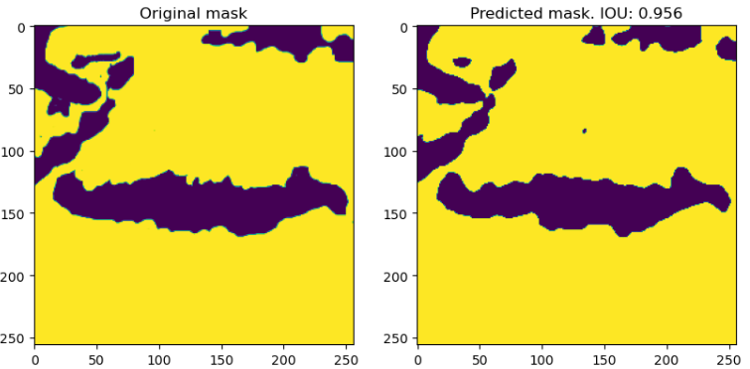
ResNext50 UNet

Slide 7
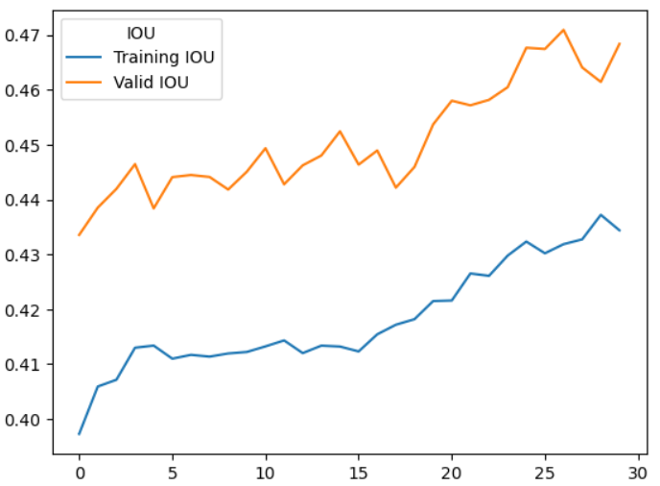
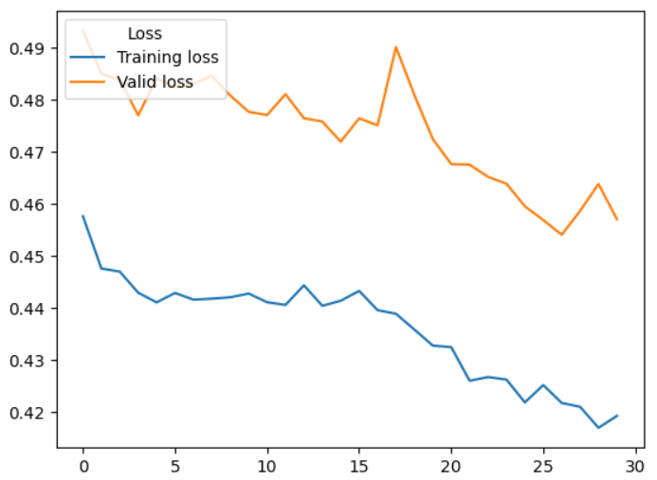
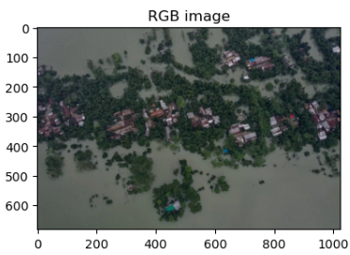
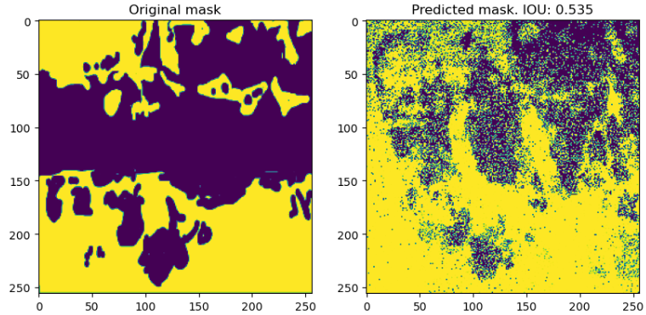
VIT

Slide 8
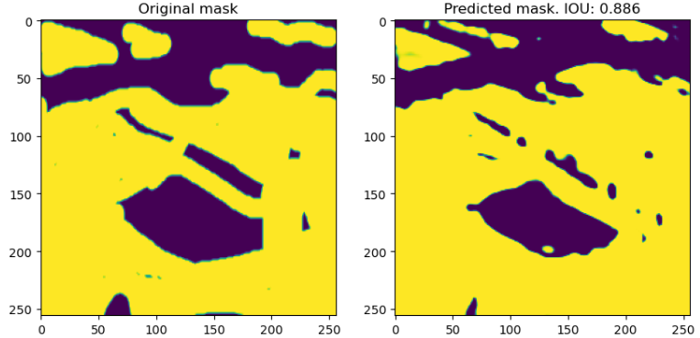
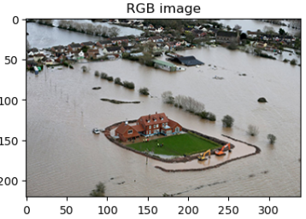
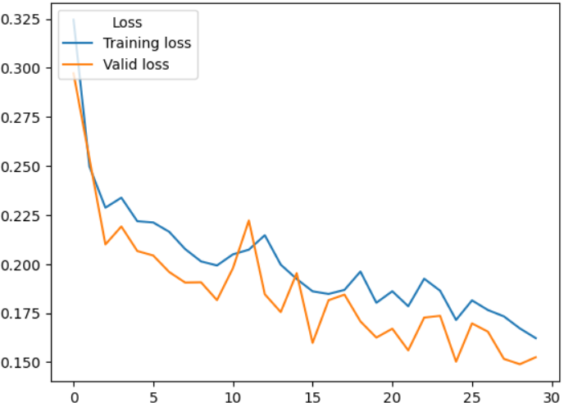
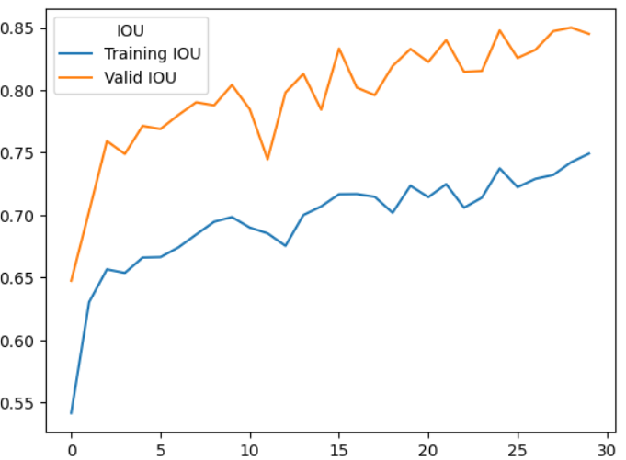
DeepLabV3+

Slide 9
Comparison of models
Model | Mean IOU
ResNext50 + UNet | 95.1%
UNet | 85.9%
DeepLabV3+ | 85%
U2Net | 84.6%
VIT | 47

Slide 10
Conclusion and future work
The UNet results are very close to the ResNext50UNet and DeepLabV3+.
During my experimentations I observed that using Otsu’s thresholding increased the accuracy of the models.
Even using color transforms such as ColorJitter and Normalization methods
More transformations and thresholding techniques can be explored and applied to get more accurate results.
The results of these models can be compared with Segment Anything Model (SAM).

Slide 11

Thanks for your attention
Questions?

